Slide 1
Topic & Persona
Topic: Home
Persona: Alex

Slide 2
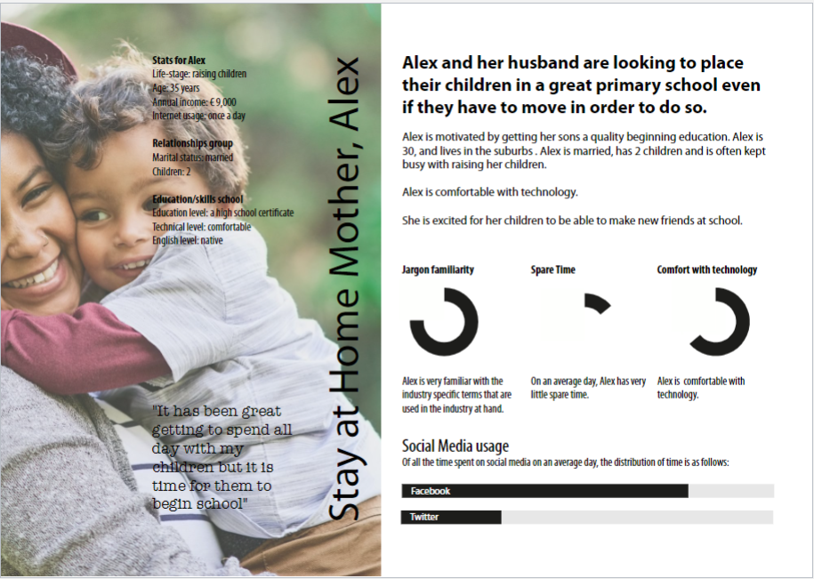

Slide 3
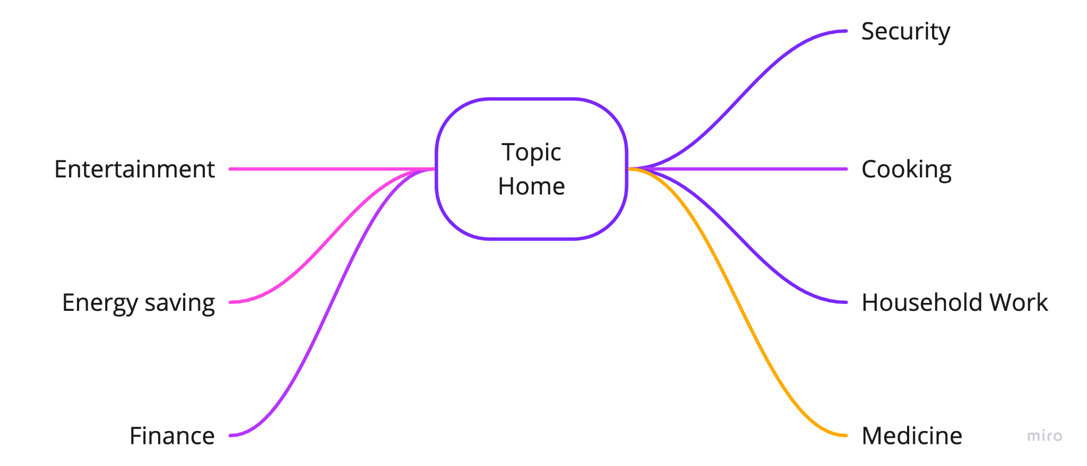
Topic home research
https://www.familyhandyman.com/list/the-10-best-home-innovations-of-the-decade/
https://dev.to/andrewbaisden/50-cool-web-and-mobile-project-ideas-for-2021-1pgl

Slide 4
Empathize
Persona research
These are most important links we’ve used to research our persona
https://www.youtube.com/watch?v=QEryds5Z3aQ&ab_channel=SimplyAllie
https://www.thebalancecareers.com/sample-day-life-of-sahm-3128974

Slide 5
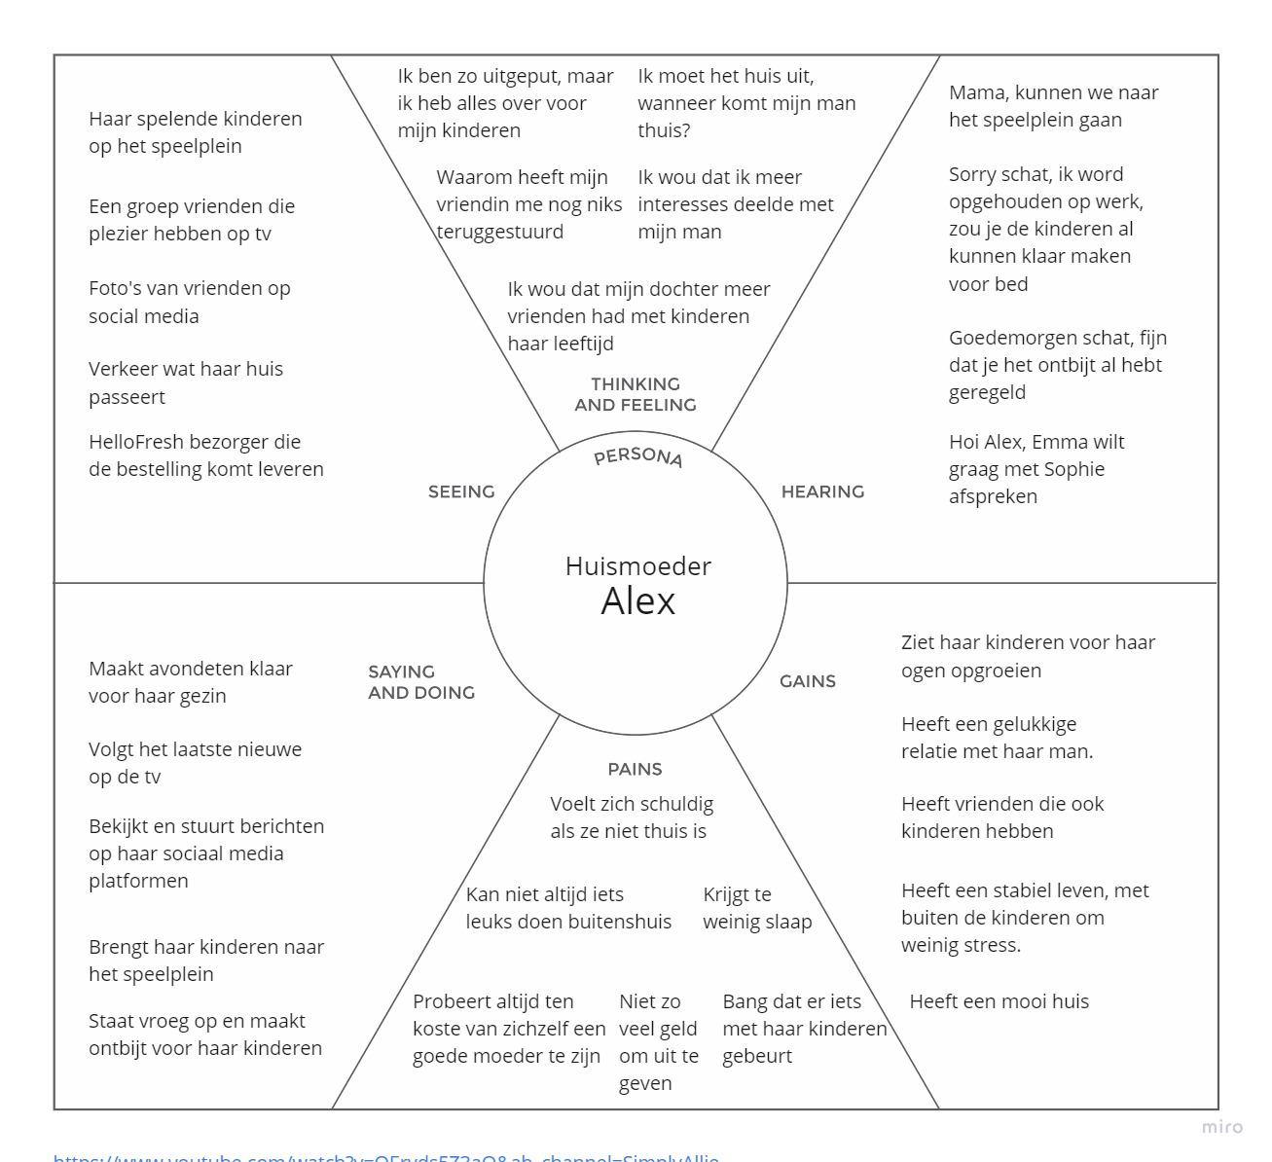

Slide 6
Define
POV Alex needs more sleep because she’s always tired
Alex needs peace of mind because she feels nervous about her kid’s well-being when she’s not around
Alex needs more shared interests with her husband because she wants to do more things together
How might we
How might we convince Alex to get more quality sleep?
How might we make getting a good sleep schedule something, which Alex aspires towards?
How might we make Alex more relaxed when her kids are not around?
How might we make Alex less nervous?
How might we make Alex and her husband do more things together?
How might we find more shared Interests between Alex and her husband?

